Slide 1














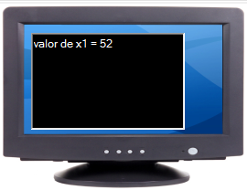
Cobol
Fortran
C
Z80
8086 3 x 3 = 9 Compiladores
8051
compilador
Maquina
Virtual
9 traducciones
Compilación
Assembler
(Z80, 8086, 8051)
Fuente
(Cobol, Fortran, C)
Compilador
Código
Intermedio
x1 = 23 + 29;
printf(“valor de x1 = %d", x1);…
ldc.i4 23
ldc.i4 29
add
stloc.0
ldstr "valor de x1 ="
call writeln#(string)
ldloc.0
ldc.i4 3
call write#(int32,int32)
mov a, #0x23
mov b, #0x29
add a, b
DA a
mov bx,1
mov cx,bytecount
lea dx,buffer
int 21h
……
(load const)
+
Código de Máquina
Máquina Virtual
En la instalación o
en la 1° vez que
se carga el método
00110000001111000000000000010010
11000000001111000000000000010010
00000011110000110000000000010010
11110001000110010000000000000000
Ejecución CLR
Common Language Runtime ("entorno en tiempo de ejecución de lenguaje común“)
Notes:
The diagram above illustrates the process used to compile and execute managed code, that is, code that uses the CLR. Source code written in C#, VB.NET, or some other language that targets the CLR is first transformed into MSIL by the appropriate language compiler. Before execution, this MSIL is JIT compiled into native code for whatever processor the code will run on. The default is to JIT compile each method when it is first called, but it’s also possible to “pre-JIT” the MSIL. With this option, all methods are compiled before the application is loaded, so the overhead of JIT compilation on each initial method call is avoided.
One point worth noting is that all languages targeting the CLR should exhibit roughly the same performance. While some compilers may produce better MSIL code than others, large variations in execution speed are unlikely.

Slide 2
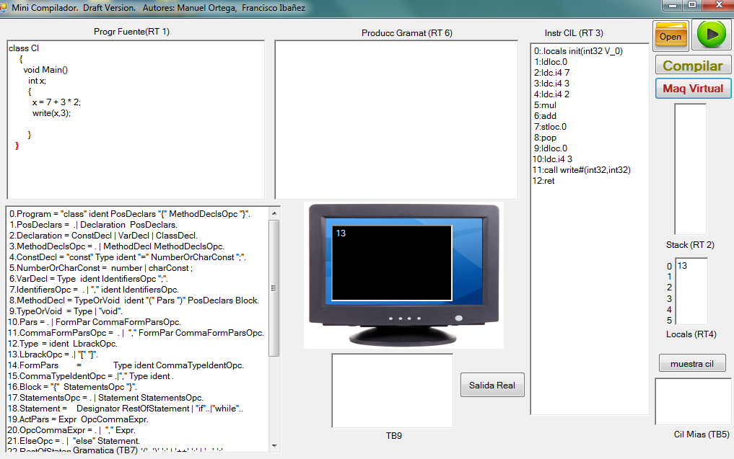
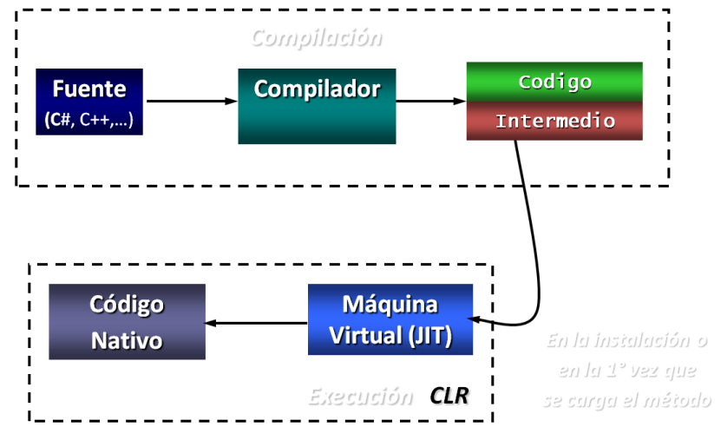
class Cl
{
void Main()
int x;
{
x = 7 + 3 * 2;
write(x,3);
}
}

Slide 3
class Cl
{
void Main()
int x;
{
x = 7 + 3 * 2;
write(x,3);
}
}
13

Slide 4
class Cl
{
void Main()
int x;
{
x = 7 + 3 * 2;
write(x,3);
}
}
13

Slide 5
class Cl
{
void Main()
int x;
{
x = 7 + 3 * 2;
write(x,3);
}
}

Slide 6
class Cl
{
void Main()
int x;
{
x = 7 + 3 * 2;
write(x,3);
}
}

Slide 9
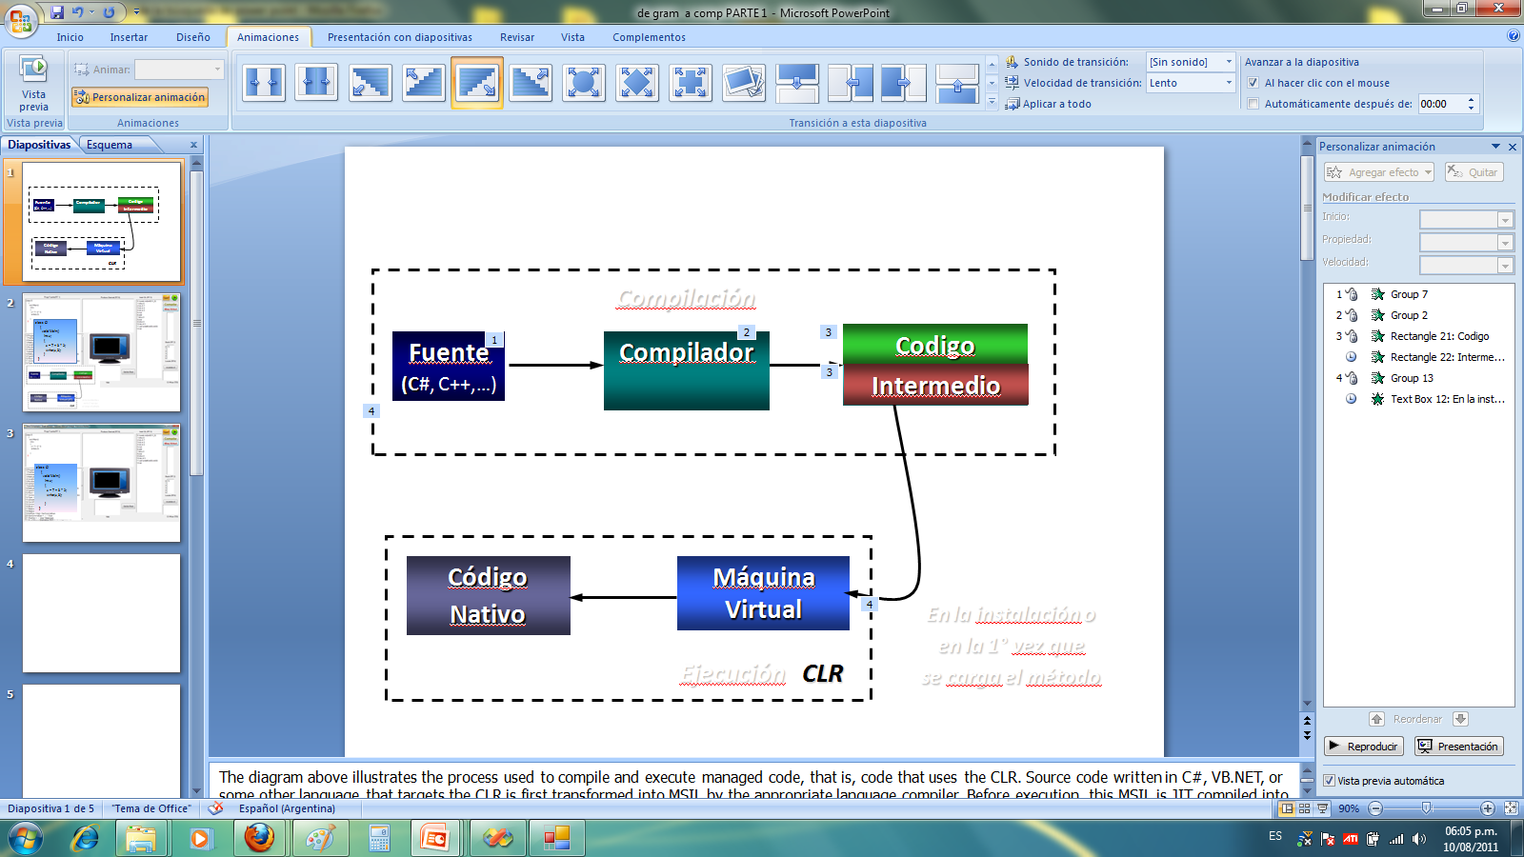

Slide 10
mov a, r2
add a, #1 ; use add rather than increment to affect C
mov r2, a
mov a, r3
addc a, #0 ; add C to most significant byte
mov r3, a
mov 0xD0, #0 ; use register bank 0
mov r0, #0x3C
mov @r0, #3
00110000001111000000000000010010
cseg at 100h
Main: mov 0xFF, #0DEh ; Disable watchdog timer
mov 0xFF, #0ADh
mov a, X
add a, Y
mov Z, a
nop
end

Slide 11



mov a, #0x23
mov b, #0x29
add a, b
DA a
00110000001111000000000000010010
11000000001111000000000000010010
00000011110000110000000000010010
11110001000110010000000000000000
x1 = 23 + 29;
Cobol
Fortran
C
Compil
mov a, #0x23
mov b, #0x29
add a, b
DA a
;
a ← 23 + 29 = 4C (wanted 52)
; a ← a + 6 = 52
Cod
Interm

